Slide 1

Murder Book— A Profile of the Los Angeles Police Department’s Homicide Case Management Framework
A Police Foundation Webinar
John Skaggs, Ret. LAPD
March 13, 2018

Slide 2
History of the Murder Book and its Benefits to
a Successful Investigation
The murder book concept was implemented in 1981 to improve case organization.
Case organization is essential for successful investigations and prosecutions.
Most agencies throughout the U.S. maintain an accordion file or folders.

Slide 3
Who Benefits Most from a Murder Book?
Lead Detective
Supervision
Prosecutors
NOTE: A homicide investigation case file is discoverable, meaning its contents may have to be turned over to defense counsel during pre-trial proceedings. When a suspect is arrested and charged, a copy of the case file (in a binder) shall be provided to the prosecutor assigned to the case upon request.

Slide 4
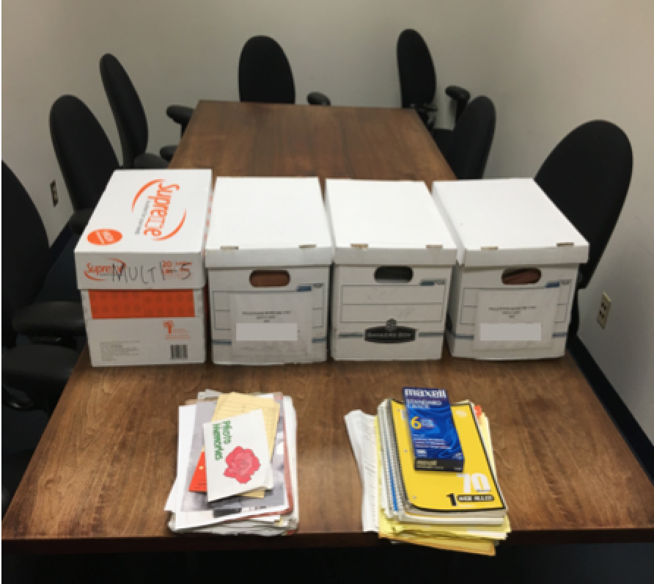
*Note: All images were taken by and are the property of John Skaggs

Slide 5
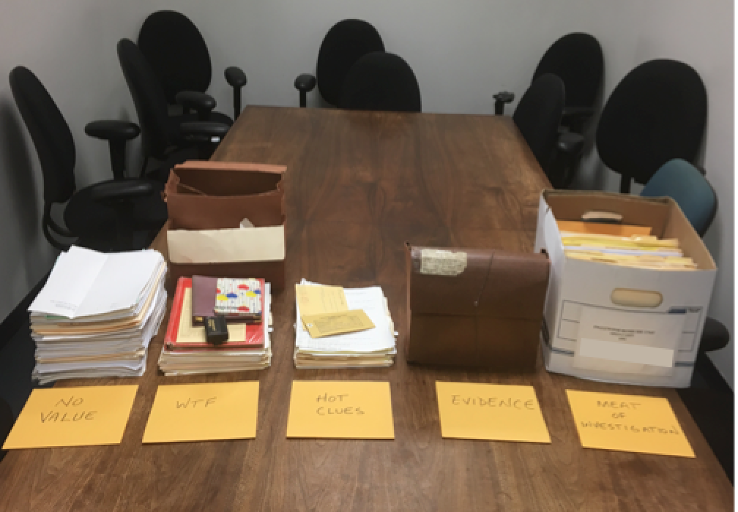

Slide 6
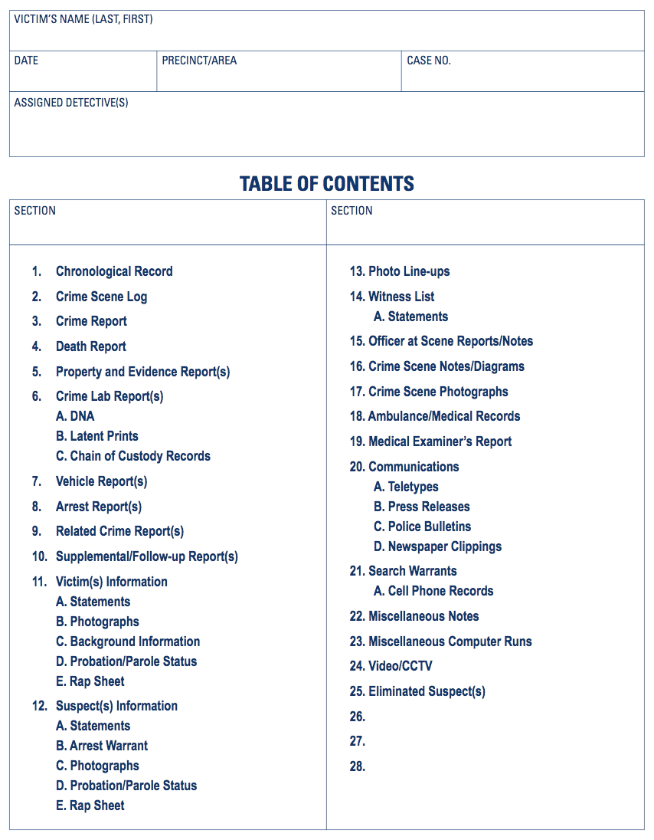

Slide 7
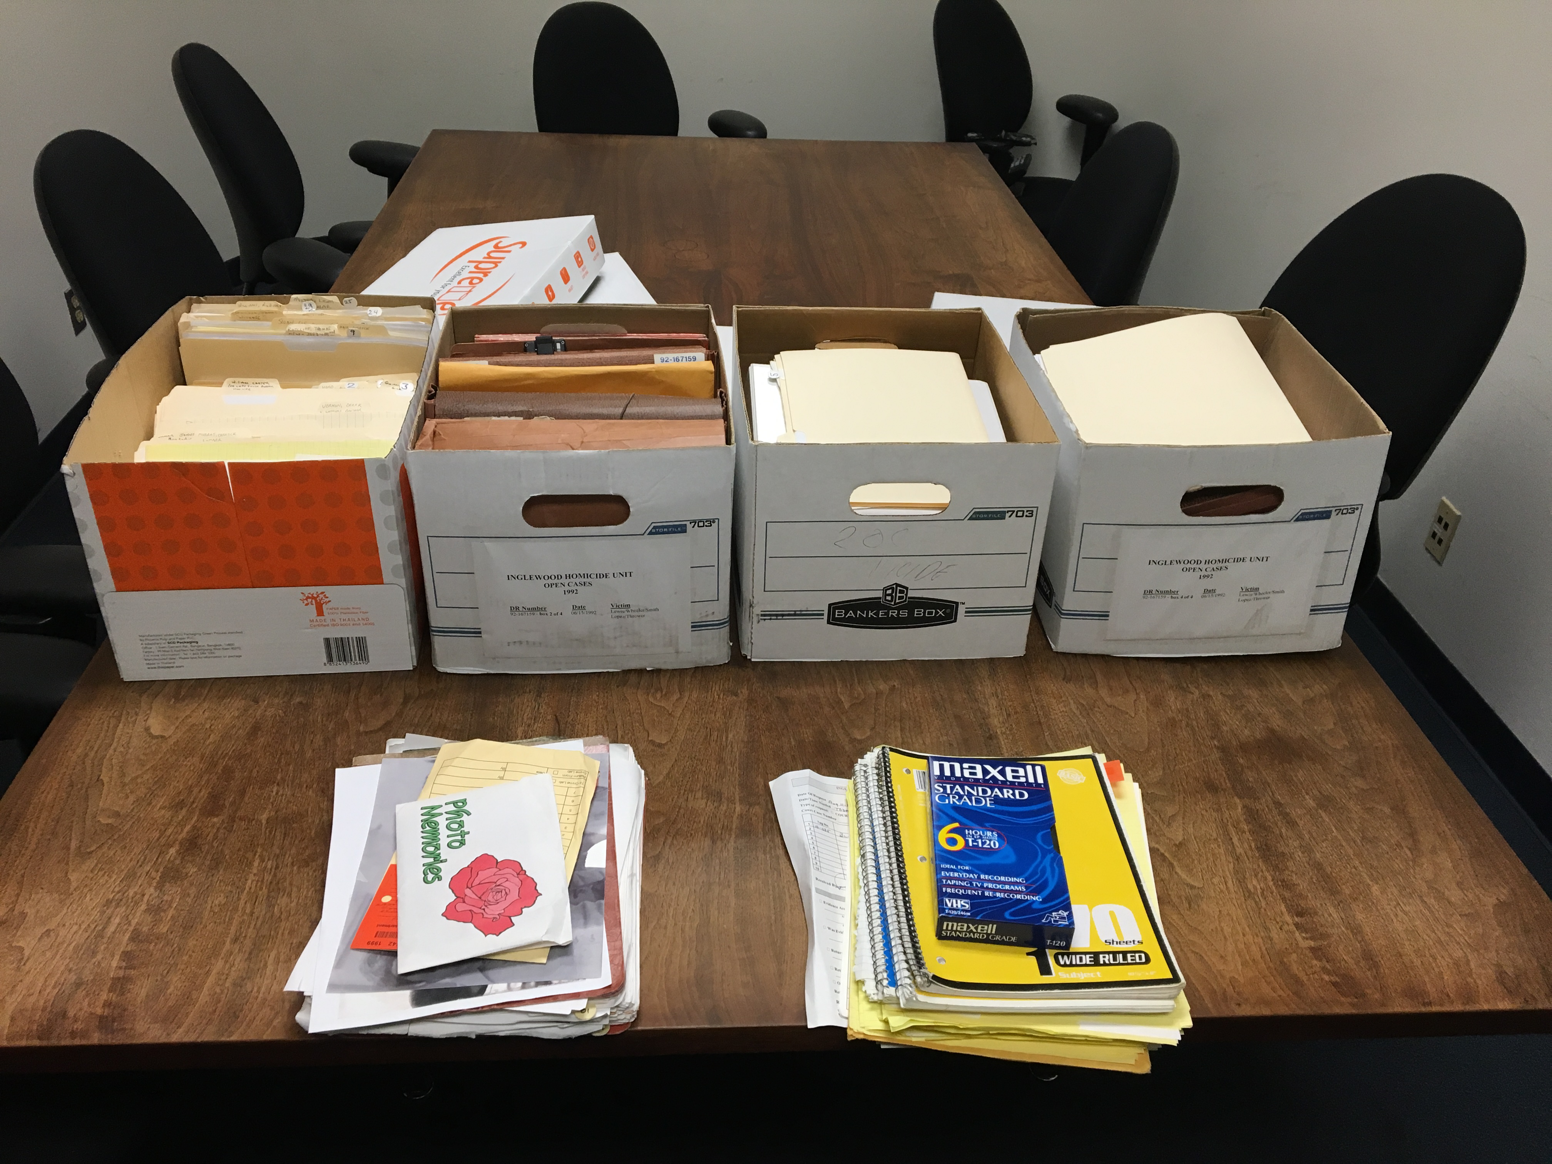
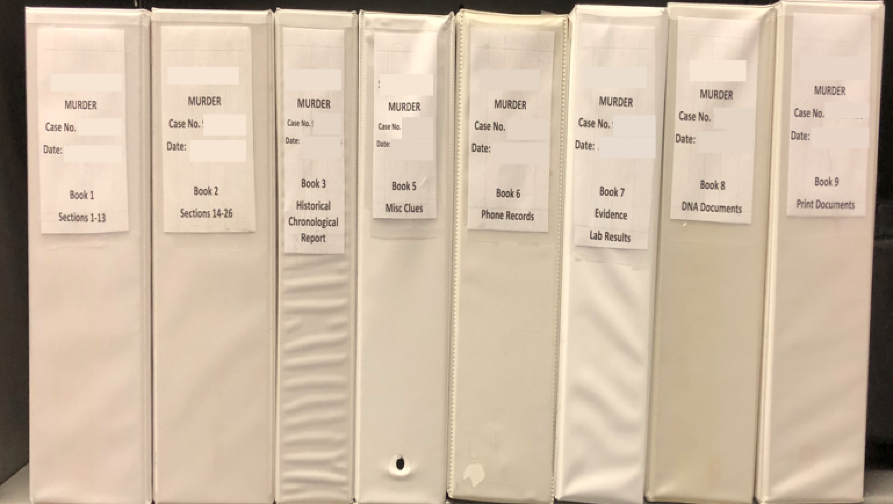
Before
After

Slide 8
High-Level Overview of the Murder Book
The Murder Book Profile can be used as a template for jurisdictions seeking to organize their files and/or develop new SOPs.
Sample, fillable templates as shown in the below slides are available in the Murder Book Profile.

Slide 9
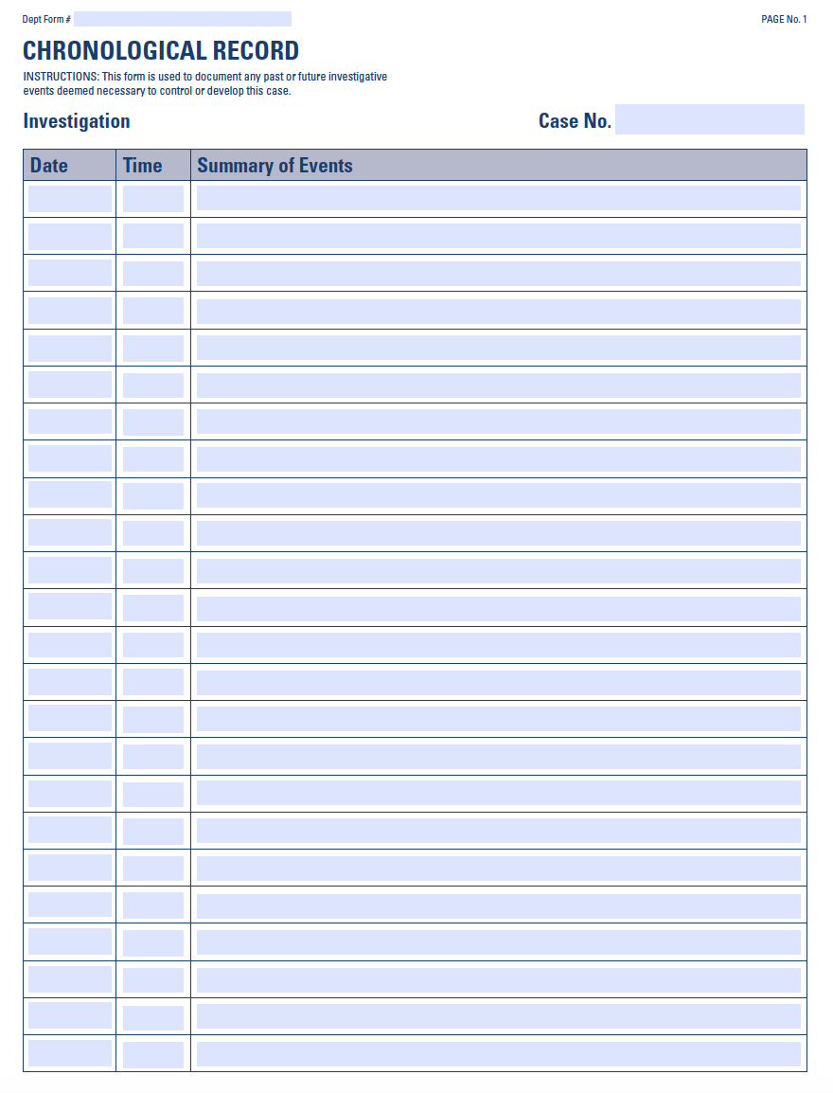
Documents, in summary and chronological order, advancements in the investigation and the need for future investigation, who performed the activity and who authored the entry into the report.
Section 1. Chronological Record
Should reference where in the Murder Book a report or notes that further explain the event can be found.
Allows the reader to understand how the investigation progressed.

Slide 10
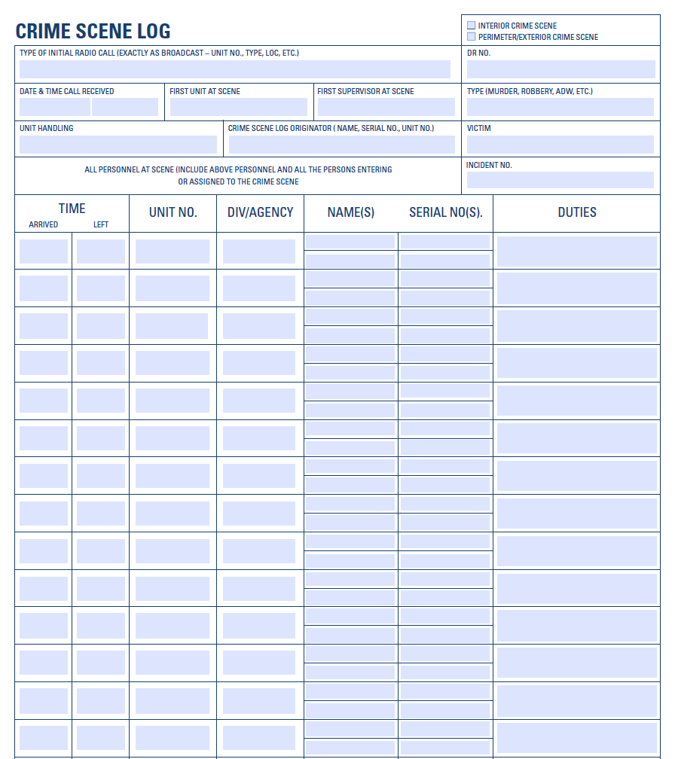
All investigations should have a crime scene log that documents all personnel present at the crime scene who enter the area not accessible to the public.
Section 2. Crime Scene Log
Should document the personnel, their names and identification numbers, time of arrival and departure, and their duties performed at the scene.
Should identify the name of the officer who maintained and completed the crime scene log.

Slide 11
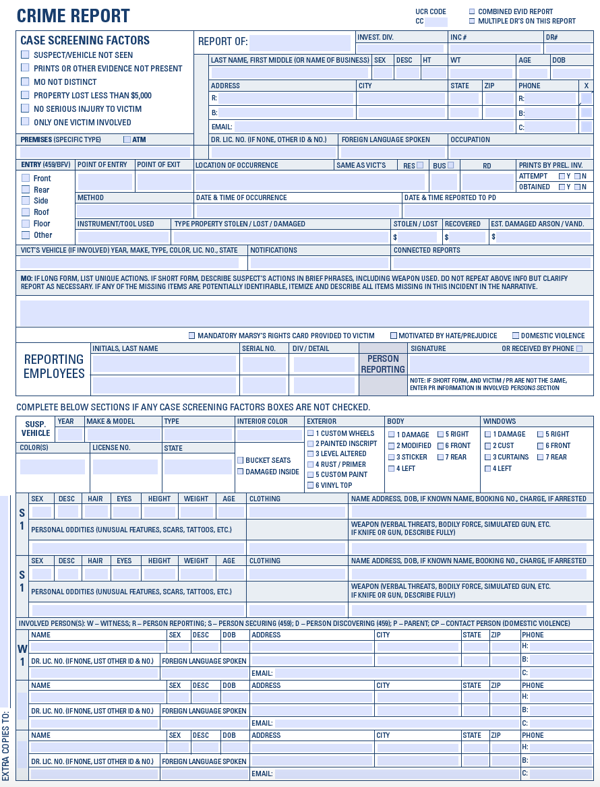
Should be completed by the primary investigator handling the investigation.
Section 3. Crime Report
Contains victim information, witness information, a summary of their statements, and a synopsis of the crime, including modus operandi.
Commonly referred to as a “24-hour” homicide report.

Slide 12
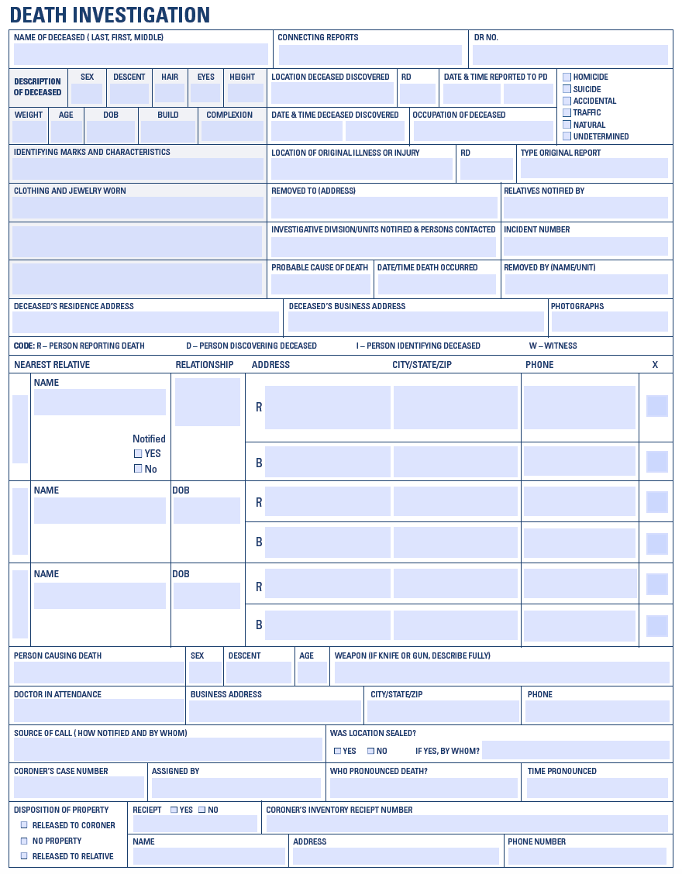
Many departments produce a death report for all deaths in their jurisdiction, whether it be from natural causes, an accident, suicide, traffic death, or homicide.
Section 4. Death Report
On criminal homicide deaths, a crime report and/or an incident report, as previously outlined, is also produced to report the crime.

Slide 13
Contains all reports regarding the recovery and storage of property and evidence (e.g., recovered property report, evidence report, and chain of custody reports).
Section 5. Property/Evidence Reports
Section 6. Crime Lab Reports
Contains requests for laboratory examination of evidence and all reports regarding the scientific analysis of evidence, including NIBIN, DNA, and latent prints completed by any crime laboratory.

Slide 14
Contains all vehicle reports pertaining to the investigation, including impound reports, photographs of the vehicle, and motor vehicle computer printouts.
Section 7. Vehicle Reports
Section 8. Arrest Reports
All arrest reports generated from the investigation should be stored here, as well as any prior arrest reports related to suspects, witnesses, and others who are involved in the investigation.
Subsections can be created to separate items related to specific individuals.

Slide 15
Contains all crime reports related to victims, suspects, witnesses, and other individuals related to the investigation.
Section 9. Related Crime Reports
Subsections can be created to separate items related to specific
individuals.
Section 10. Follow-Up Reports
Contains reports written by homicide detectives related to the current investigation that are produced after the completion of the initial crime report.
Generally, a follow-up report is used by a detective to document investigative steps taken that are important to the progress of the investigation.

Slide 16
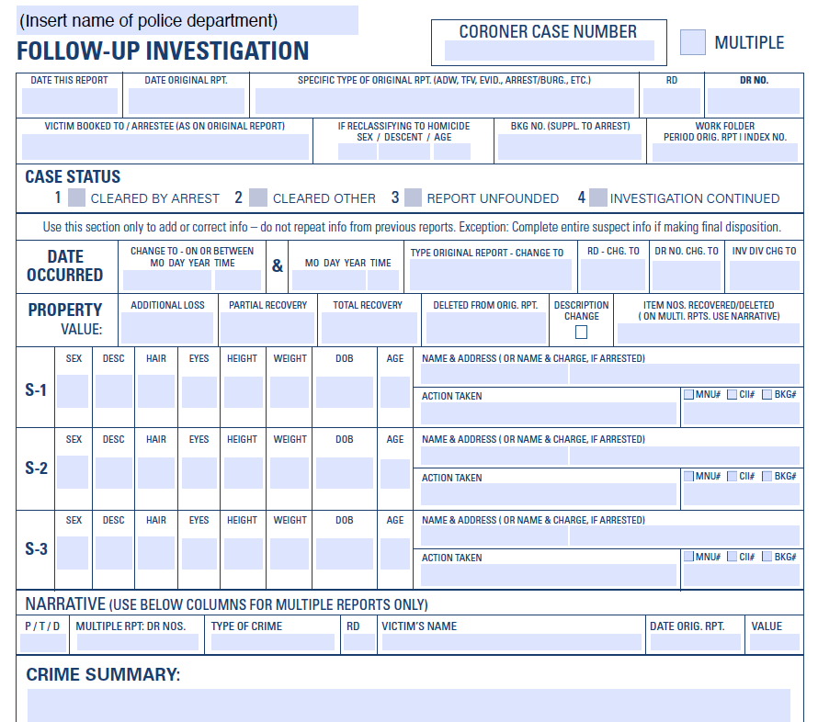
Should be produced to present a case to a prosecutor and should include all important developments in the case that support the request for charges, including statements, lab results, and crime scene descriptions.
Section 10. Follow-Up Reports (Continued)
A best practice for homicide investigations is to complete a follow-up report to document the status of an unsolved homicide investigation, required within 60 to 90 days after the murder.

Slide 17
Contains all personal information regarding the victim(s), including their rap/arrest sheet, Motor Vehicle Department information, photographs/mug shots, and other computer-generated reports.
Section 11. Victim Information
Use subdivider listing the victim’s name or designated letters if there are multiple victims.
Section 12. Suspect Information
Contains all personal information for the suspect(s), including their rap/arrest sheet, Motor Vehicle Department information, photographs/mug shots, and other reports such as their social media.
If a suspect is later eliminated as a suspect, their information should be removed and placed in the appropriate section.

Slide 18
Contains photographic arrays (6-packs) or single photographs used for conducting sequential photo line-ups.
Section 13. Photo Line Ups
Photographic admonition and any documents written and/or signed by witnesses should be kept in this section.
Section 14. Witness List / Statements
List of all witnesses should be kept at the front of this section and should include the assigned witness number (if given one), name, address, phone number, and the recording number if the interview was recorded.
Witness statement report and/or notes are stored in the section corresponding with their assigned witness number.

Slide 19
Contains any reports, such as an initial responding officer’s report or supplemental reports and notes completed by officers who responded to the scene and performed essential duties (e.g., a neighborhood canvass) or discovered important evidence or information.
Section 15. Officer at Scene Report /Notes
Should detail the actions performed and the information or evidence discovered.
Section 16. Crime Scene Notes/Diagram
Investigators should document the description of the crime scene, a diagram that depicts the location of the body, items of evidence, parked vehicles along with their descriptions and license plate numbers, and any other items of interest.
Should also include diagrams completed by officers or detectives at the scene and by crime lab personnel who create handwritten diagrams or computer-aided crime scene diagrams.

Slide 20
Contains all photographs taken during the crime scene investigation.
Section 17. Crime Scene Photographs
The photos may be of the victim, the surrounding area, evidence, involved vehicles, witnesses, potential witnesses, and suspects. At a minimum, proof sheets and CDs/thumb drives containing all photos should be stored here.
Section 18. Ambulance/Medical Records
Includes reports such as a paramedic run sheet produced by Emergency Medical Technicians (EMT) who responded to the scene or reports from medical personnel at the hospital, including relevant medical records.
The location to which the victim was transported or treated and the identity of medical personnel who recovered evidence (e.g., clothing from the victim and/or suspect) should be stored in this section.

Slide 21
All reports related to or produced by the Medical Examiner’s Office should be stored in this section. Detectives should include diagrams and photographs of the decedent’s body and the autopsy report.
Section 19. Medical Examiner Reports
Section 20. Communications
Contains all teletypes, press releases, police bulletins, wanted flyers, newspaper clippings, and agency-generated social media posts regarding the investigation.
Section 21. Search Warrants
Contains all Search Warrants, the Return to Search Warrant, and related documents should be stored in this section.

Slide 22
Section 22. Miscellaneous Notes
Reserved for general notes, such as canvassing notes, taken by detectives that do not belong in any other section.
Section 23. Miscellaneous Computer Runs
Contains general computer runs such as Lexus/Nexus reports or Google queries that are not required to be stored in any other section.
Section 24. Video/CCTV
Contains video recordings, captured in and around the area of the crime scene.

Slide 23
Information on suspects that have been eliminated during the investigation should be kept here.
Section 25. Eliminated Suspect(s)
Sections 26-28. Additional Documents
Three extra sections at the back of the Murder Book give detectives a place to organize and store any additional documents related to the case, such as the victim’s phone records, crime scene tower dump records, social media posts, and the like.

Slide 24





National Resource and Technical Assistance Center for Improving Law Enforcement Investigations (NRTAC)
Project Websites: centerforimprovinginvestigations.org crimegunintelcenters.org
Webinar Speaker:
John Skaggs
john1skaggs@gmail.com

